Slide 1
Back end Digital Flow
Basics
Patrice Delpy 2018

Slide 2
Manufacturing test
Testing is one of the most expensive parts of total of manufacturing cost
Yield of any chip is < 100%
Must test chips after manufacturing before delivery to customers to only ship good parts

Slide 3
Stuck
Faulty line permanently set to 0 or 1
Controllability
Reflects the difficulty of setting a signal line to a
required logic value from primary inputs
Observability
Reflects the difficulty of propagating the logic
value of the signal line to primary outputs
Testability Analysis:
The process of assessing the testability of a logic circuit

Slide 4
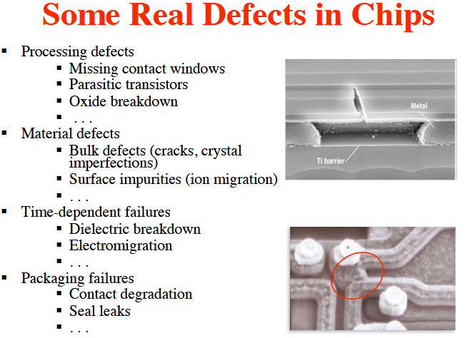

Slide 5
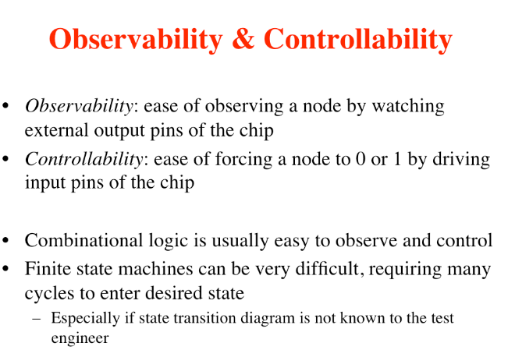

Slide 6
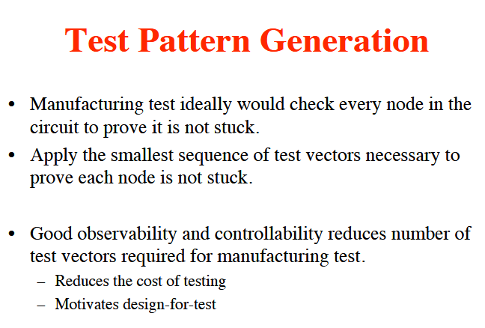

Slide 7
Electronic Design Automation for IC System Design, Verification, and Testing

Slide 8
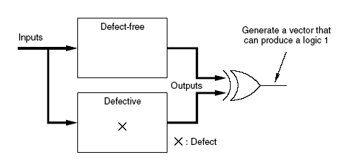
ATPG concept
Generate an input vector that can distinguish the defect-free circuit from the hypothetically defective one

Slide 9
ATPG problem
ATPG: Automatic test pattern generation
  Given
    A circuit (usually at gate-level)
    A fault model ( stuck-at type)
  Find
    A set of input vectors to detect all modeled faults.
Core solution: Find a test vector for a given fault.

Slide 10
Fault models
Instead of targeting specific defects, fault models are used to capture the logical effect of the underlying defect
Fault models considered in this chapter:
  Stuck-at fault
  Bridging fault
  Transition fault
  Path-delay fault

Slide 11
Purpose of test
how to generate a small test patterns set which guarantees a certain (high) fault coverage?

Slide 12
Defect categories
Random defects, which are independent of designs
and processes
Systematic defects, which depend on designs and
processes used for manufacturing
For example, random defects might be caused by
random particles scattered on a wafer during
manufacturing

Slide 13
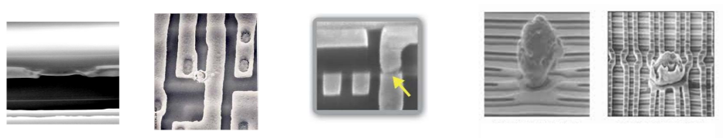

Slide 14
continuous shrinking of feature sizes, below the 180nm technology , system defects have a larger impact on yield than random defects

Slide 15
Role of Test
If you design a product, fabricate, and test it, and it fails the test, then there must be a cause for the failure
Test was wrong
The fabrication process was faulty
The design was incorrect
The specification problem
The role of testing is to detect whether something went wrong
Correctness and effectiveness of testing is most important for quality products

Slide 16
Benefits of test
The purpose of testing is to weed out all bad
products before they reach the user
Quality means satisfying the user’s needs at a minimum cost

Slide 17
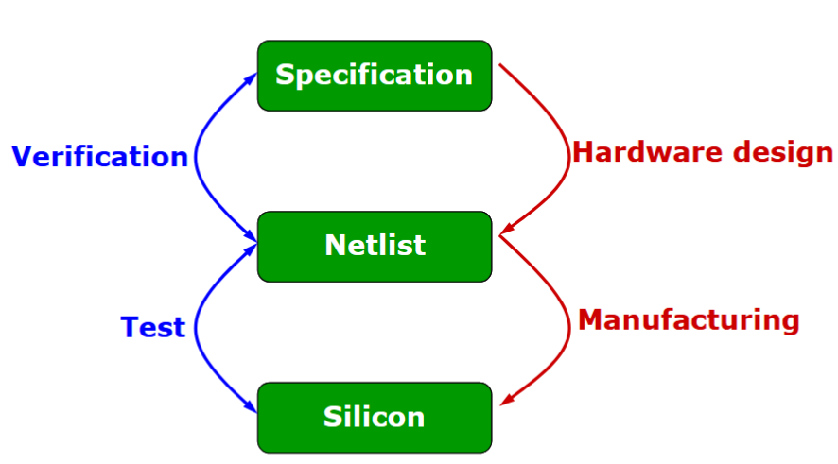
Verification vs test

Slide 18
Defect, Fault and error
Defect
A defect is the unintended difference between the implemented hardware and its intended design
Defects occur either during manufacture or during the use of devices
Fault
A representation of a defect at the abstracted function level
Error
A wrong output signal produced by a defective system
An error is caused by a Fault or a design error

Slide 19
Typical types of defects
Extra and missing material
■
Primarily caused by dust particles on the mask or
wafer surface, or in the processing chemicals
□
Oxide breakdown
■
Primarily caused by insufficient oxygen at the
interface of silicon (Si) and silicon dioxide (SiO
2
),
chemical contamination, and crystal defects
□
Electromigration
■
Primarily caused by the transport of metal atoms
when a current flows through the wire
□
Because of a low melting point, aluminum has large
self-diffusion properties, which increase its
electromigration liability

Slide 20
Ideals test & real tests
Ideal tests
Ideal tests detect all defects produced in the manufacturing process
Ideal tests pass all functionally good devices
Very large numbers and varieties of possible defects need to be tested
Difficult to generate tests for some real defects
Real tests
Based on analyzable fault models, which may not map on real defects
Incomplete coverage of modeled faults due to high complexity
Some good chips are rejected. The fraction (or percentage) of such chips is called the
yield loss
Some bad chips pass tests. The fraction (or percentage) of bad chips among all passing chips is called the
defect level

Slide 21
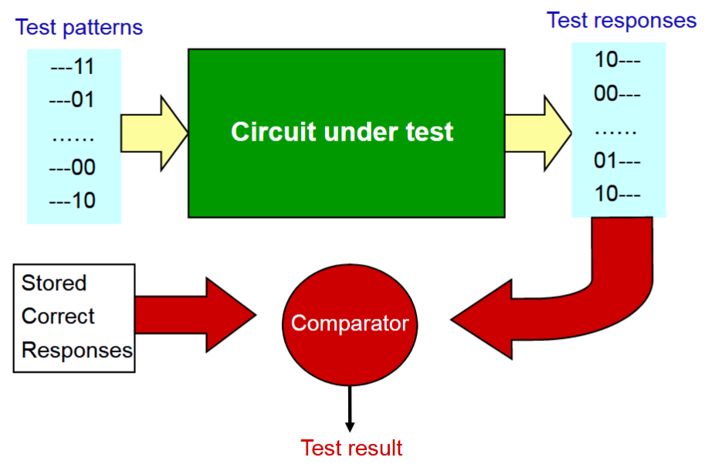
How to test chips ?

Slide 22
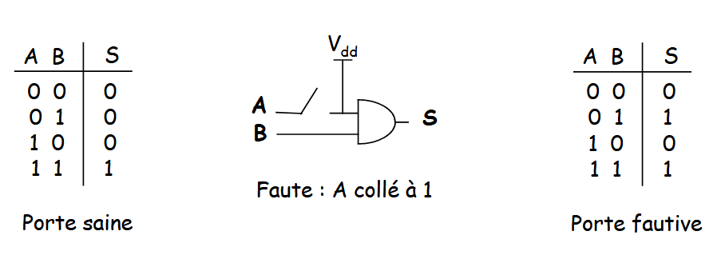
Illustration of ATPG

Slide 23
Fault simulation
The main goals of fault simulation

Measuring the effectiveness of the test patterns
Set of undetected daults
Fault coverage calculation

Slide 24
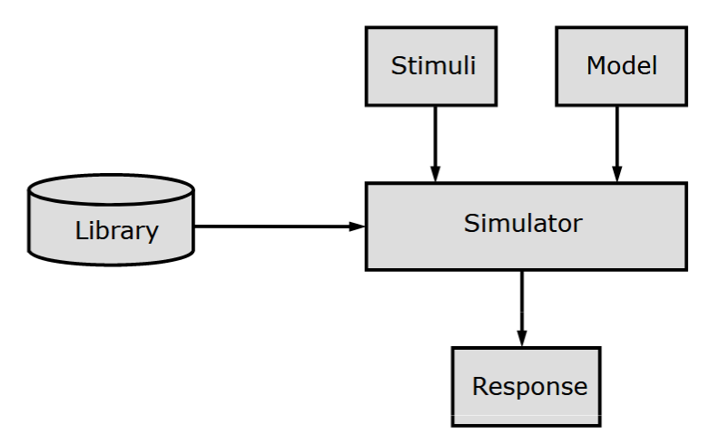
Fault Simulation process

Slide 25
Last scan-in shift cycle
Launch cycle
Capture cycle

Slide 26
DFT techniques
Permit access to internal nodes of a circuit without requiring a separate external
connection for each node accessed

Slide 27
Scan chain design
Serial data = shift register
Replace FF by scan FF
A multiplexer is placed at the data input of a flip-flop
To permit a selection of two different data inputs
d0: (normal system operation)
d1: (test mode).

Slide 28
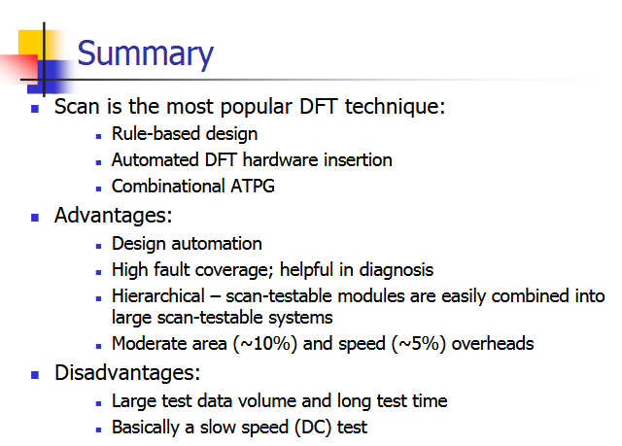

Slide 29
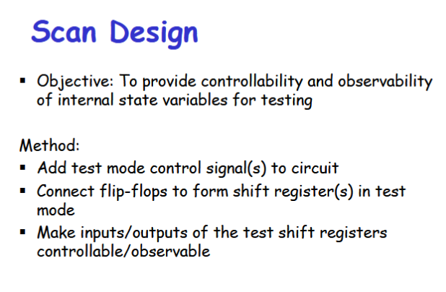

Slide 30
12: Design for Testability
17
CMOS VLSI Design
CMOS VLSI Design
4th Ed.
ATPG

Test pattern generation is tedious

Automatic Test Pattern Generation (ATPG) tools
produce a good set of vectors for each block of
combinational logic

Scan chains are used to control and observe the
blocks

Complete coverage requires a large number of
vectors, raising the cost of tes
http://pages.hmc.edu/harris/cmosvlsi/4e/lect/lect12.pdf

Slide 31
Circuit and testing springer
ftp://doc.nit.ac.ir/cee/y.baleghi/Fault-Tolerant/Books/VLSI_Testing.pdf
https://mtechlib.files.wordpress.com/2016/07/essentials-of-electronic-testing-for-digital-memory-and-mixed-signal-vlsi-circuits.pdf

Slide 32
Nanometer Technology Designs: High-Quality Delay Tests
An Introduction to Logic Circuit Testing (Synthesis Lectures on Digital Circuits and Systems)(Repost)
Testing for Small-Delay Defects in Nanoscale CMOS Integrated Circuits (Repost)

Slide 33
Make all flip-flops observable by putting them into a scan chain and using scan latches
https://www.utdallas.edu/~zhoud/EE6306/lecture%20slides/ASIC%202011%20Chapter%208%20%20Verification%20and%20Testing.pdf
Testing of Digital Systems
De N. K. Jha, S. Gupta

Slide 34
Q
DI
Q,SO
DI
D
Q
MUX
D
Q
SI
CK
CK
N/T
(SE)

Slide 35
Combinational
Circuits
Q
D
Q
D
Q
D
Q
D
SO
SI
SI
SI
SI
SE
CLK

Slide 36
http://www.facweb.iitkgp.ernet.in/~isg/TESTING/SLIDES/L08a-Design-for-Testability-1.pdf

